Slide 1
The operation
Árpád Juhász MD PhD
surgeon
University of Pécs, Medical School
Dept of Surgical Research and Techniques

Slide 2
Surgical indications / contraindications
why is operation necessary?
can the operation help the patient?
do we know all the alternatives of the operation?
- consultation
„ It is not necessary everybody to operate who we can
or because of the traditions!”
Gábor Petri
Basic surgical techniques – Pécs, 09.22.2015.

Slide 3
Surgical indications / contraindications
why is operation necessary?
can the operation help the patient?
do we know all the alternatives of the operation?
- consultation
riscs
advantages /disadvantages
general condition of the patient
types of indication:
vital indication
absolute indication
relative indication
Basic surgical techniques – Pécs, 09.22.2015.

Slide 4
Surgical indications / contraindications
contraindications
based on the level of indication
claim of human dignitary (????)
risc of the operation
preoperative examination
low / medium / high risk surgery
Basic surgical techniques – Pécs, 09.22.2015.

Slide 5
Surgical indications / contraindications
influencing factors which increase the surgical risk
acute surgery
no enough time to prepare the patient
no enough information about patient history
Basic surgical techniques – Pécs, 09.22.2015.

Slide 6
Surgical indications / contraindications
influencing factors which increase the surgical risk
acute surgery
duration is more than 2 hours
slow-down of circulation
accumulation of drugs
hypotermy
risc of infection
Basic surgical techniques – Pécs, 09.22.2015.

Slide 7
Surgical indications / contraindications
influencing factors which increase the surgical risk
acute surgery
duration is more than 2 hours
age over 65
biological age – calender age
interactions bw drugs
used for a long period of time – given during
perioperative period
cardiopulmonary deficiency
Basic surgical techniques – Pécs, 09.22.2015.

Slide 8
Surgical indications / contraindications
influencing factors which increase the surgical risk
acute surgery
duration is more than 2 hours
age over 65
pregnancy
two patiens !!!!
anatomical alterations
anaesthetical drugs can be teratogen (i.e. N2O)
Basic surgical techniques – Pécs, 09.22.2015.

Slide 9
Surgical indications / contraindications
influencing factors which increase the surgical risk
acute surgery
duration is more than 2 hours
age over 65
pregnancy
malignancy, oncotherapy
decreased function of the immune system
radiotherapy (local inflammation)
wrong general status
Basic surgical techniques – Pécs, 09.22.2015.

Slide 10
Surgical indications / contraindications
influencing factors which increase the surgical risk
acute surgery
duration is more than 2 hours
age over 65
pregnancy
malignancy, oncotherapy
malnutrition, obesity
diffuculty with intubation
accumulation of drugs in fat
respiratory disturbancy
wrong wound healing
Basic surgical techniques – Pécs, 09.22.2015.

Slide 11
Surgical indications / contraindications
influencing factors which increase the surgical risk
acute surgery
duration is more than 2 hours
age over 65
pregnancy
malignancy, oncotherapy
malnutrition, obesity
smoking / alcohol consumption
Basic surgical techniques – Pécs, 09.22.2015.

Slide 12
Surgical indications / contraindications
influencing factors which increase the surgical risk
organ alterations
cardio-respiratory
hypertension
diabetes
cirrhosis …
Basic surgical techniques – Pécs, 09.22.2015.

Slide 13
Surgical indications / contraindications
influencing factors which increase the surgical risk
organ alterations
hypovolaemy / shock
acute / chronic inflammations
respiratory, urinary, GI
Basic surgical techniques – Pécs, 09.22.2015.

Slide 14
Surgical indications / contraindications
influencing factors which increase the surgical risk
organ alterations
hypovolaemy
acute / chronic inflammations
thrombosis
acute organ insufficiencies
heart, lung, kidney, liver …
acute endocrine disorders
Basic surgical techniques – Pécs, 09.22.2015.

Slide 15
Preoperative examinations
preparation before elective surgery – acute surgery
examinations
communication with the patient, informed consent
physical examination
lab
radiology
semiinvasiv / invasiv instrumental examinations
preop hyperalimentation
fasting at least 6 hours prior to surgery
purge – empty intenstinal tract
urinary catheter, G-tube, stabil vein
thrombosis prophylaxis
Basic surgical techniques – Pécs, 09.22.2015.

Slide 16
Surgical approaches
goal:
ideal and easy approach of affected organs
small and esthetic scar
„CICATRIX OPTIMA”
surgeons have to operate using
plastic surgical principles!
Basic surgical techniques – Pécs, 09.22.2015.

Slide 17
Surgical approaches
opening of the abdominal cavity– laparotomy
opening of the chest – thoracotomy
thoracolaparotomy
Basic surgical techniques – Pécs, 09.22.2015.

Slide 18
Surgical approaches
laparotomy: vertical / transverse / oblique
vertical
median
paramedian
transrectal
pararectal
lateral transmuscular
transverse
transrectal
Pfannenstiel
(can be muscle-splitting)
Basic surgical techniques – Pécs, 09.22.2015.

Slide 19
Surgical approaches
laparotomy
oblique
inguinal transmuscular
paracostal
subcostal
muscle-splitting incisions
(McBurney)
Bergmann-Israel incision
Basic surgical techniques – Pécs, 09.22.2015.

Slide 20
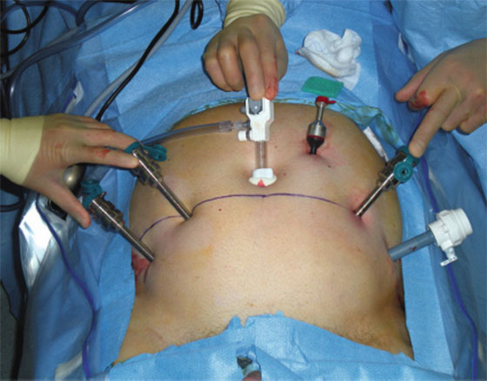
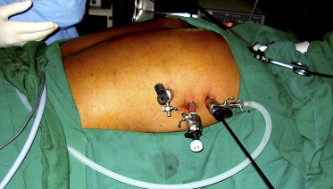
Surgical approaches
laparoscopy
thoracoscopy
Basic surgical techniques – Pécs, 09.22.2015.

Slide 21
Thank you the attention!

