Slide 1
Clinical aspect of oropharyngeal cancer and the tumors of oral cavity
István Szanyi MD., PhD

Slide 2
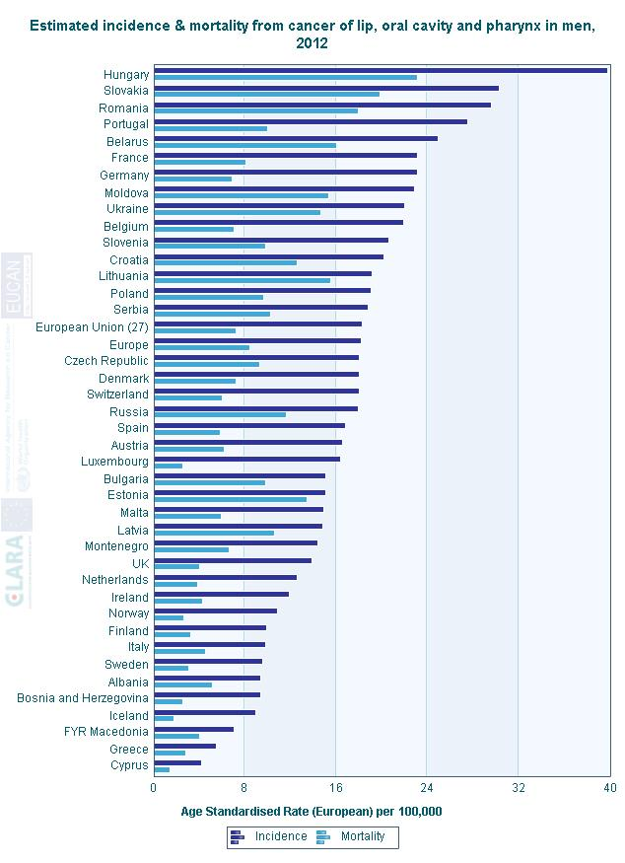
Globocan-táblázat
WHO, EUCAN

Slide 3
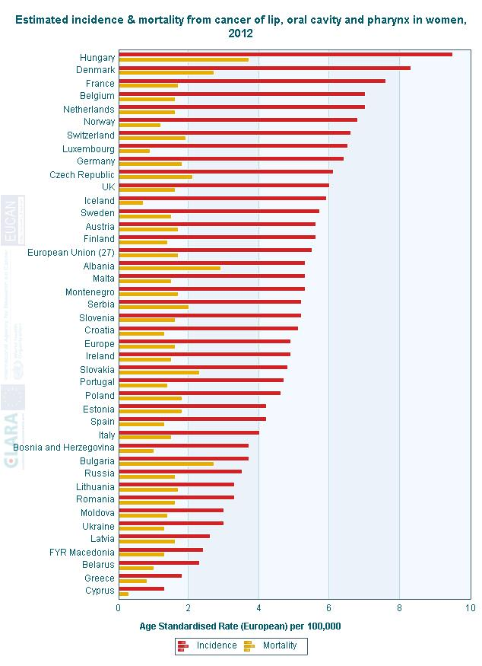
WHO, EUCAN

Slide 4

Mortality of oral cavity and oropharyngeal tumors in Hungary

Slide 5
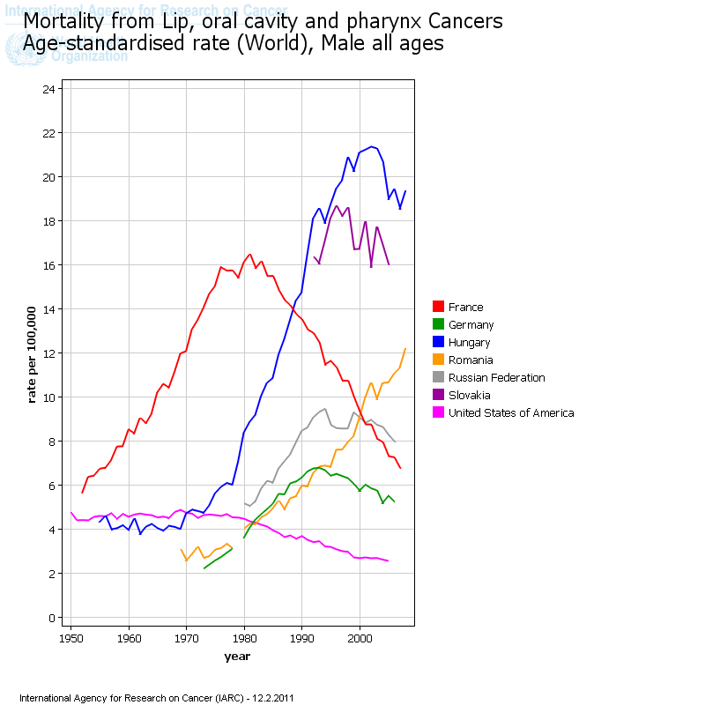
Mortality trends of Head and Neck tumors.
WHO data (2008)
Mortality of H&N tumors, male
USA and Western Europe
France and
Middle- and Eastern Europe
Hungary after 2000
Notes:
The mortality trends of H.,Slov., Rum., increased to 2000, then turned down and decreased, the same turn happened France and USA in 1980. This decreasing goes parallel with the trend of the smoking.)

Slide 6
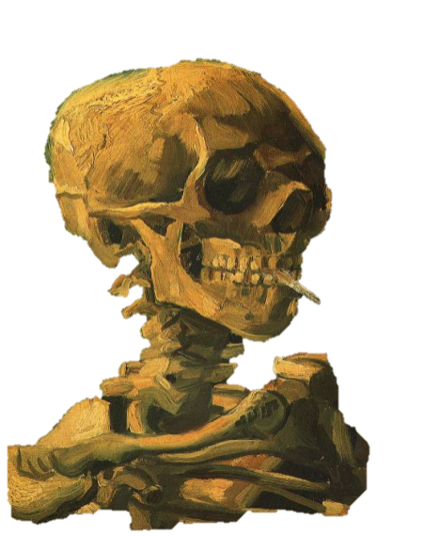

Risk factors
The most important risk factors are tobbacco smoking and alcohol consumption
  nitrosamines,
  Aromatyc hydrocarbons (ie.benzpyrene)
Their effect is synergistic in head and neck tissues
In 80-90% of head and neck malignancies, patients have history of both risk factors
Notes:
nitrosamines (TSNs)
Aromatyc hydrocarbons (e.g. benzpyrene)

Slide 7
Risk factors
Other tobacco use: chewing tobacco, cigar, pipe (lip carcinoma)
Chewing betel nut (in Southeast Asia leading cause of cancer of the buccal mucosa)
Human Papilloma Virus 16 &18
GERD (Reflux disease)
Poor oral hygiene
Prior irradiation to the head and neck region
Notes:
Tobacco chewing, Chewing betel nut. cigar [szi 'ga],

Slide 8
HPV epidemiology (American Academy of Otolaryngology – Head & Neck Surgery)
Today the leading cause of OPC is the HPV infection
Country | 1985 | 2004 | References
USA | 40 % | 80 % | Worden et al (J.Clinic.Oncol., 2009)
UK | 22 % | 67 % | Jensen et al (BMJ, 2010)
Australia | 19 % | 60 % | Hong et al (Vaccine, 2010)
Sweden | 29 % | 93 % | Nasman et al (Cancer 2009)

Slide 9
HPV positive tumors in nonsmoking patients
The most of the tumors of the nonsmoking oropharyngeal cancer patients showed HPV positivity. Recent studies declair that HPV negative oral cavity and oropharyngeal carcinoma, induced by tobacco smoking and alcohol consumption, while – in contrast – tumors of non-smokers appears to be HPV positive.
HPV positive tumors react more favorable to chemoradiotherapy, opposed to HPV negative ones.
Notes:
HPV16 that was detected is also thought to play a role in the pathogenesis of cervical cancer. A transmission by oral sex route has been proposed.
There is an increasing amount of studies about HPV negativity of oral cavity and oropharyngeal neoplasias, induced by tobacco smoking and alcohol consumption, while – in contrast – tumors of non-smokers appears to be HPV positive. HPV positive tumors react more favorable to chemoradiotherapy, opposed to HPV negative ones. Thus, presence of HPV serves as a significant factor affecting prognosis and therapy.

Slide 10
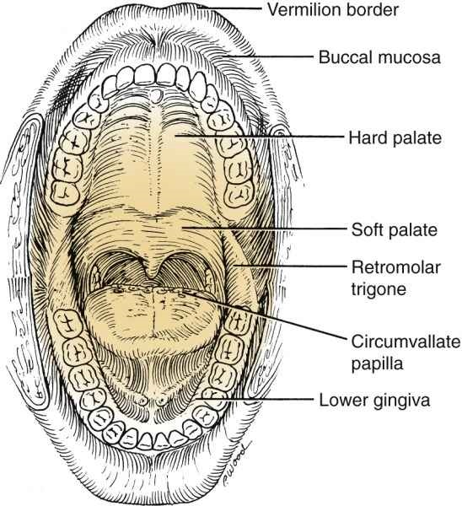
Primary sites of oral cavity tumors
lips
floor of the mouth
tongue
upper and lower gingiva mucosa
buccal mucosa
hard palate mucosa
retromolar trigone
Notes:
Retromolar Trigone [‘traigoun]

Slide 11
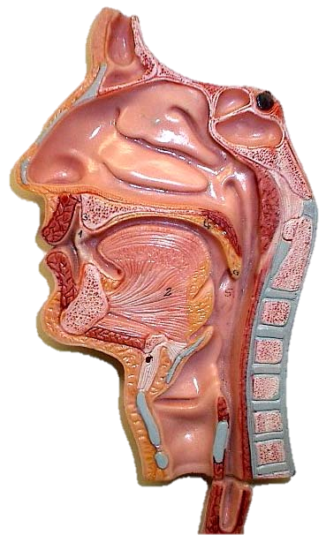
Borders of oropharynx
Superior - soft palate, velopharyngeal isthmus
Inferior - upper margin of epiglottis
Anterior - Oropharyngeal isthmus
Posterior - cervical spine
(C2-3)
Notes:
Aoropharynx a szájüreg folytatása, a határai:

Slide 12
Structures of oropharynx
Palatin tonsils,
Soft palate,
Lingual tonsils,
Preepiglottic fold,
Posterior pharyngeal wall.
Notes:
A következő struktúrák találhatók azoropharynxban:

Slide 13
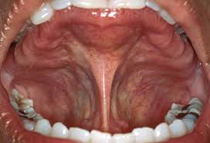
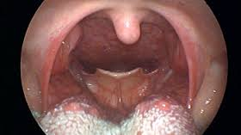
Oral cavity and oropharynx

Slide 14
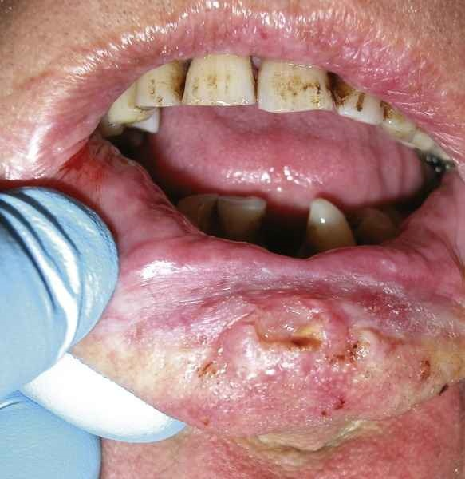
Carcinoma of the lower lip
Notes:
Szeretnék példákat mutatni az ajak és szájüregi daganatok különböző megjelenési formáiról

Slide 15
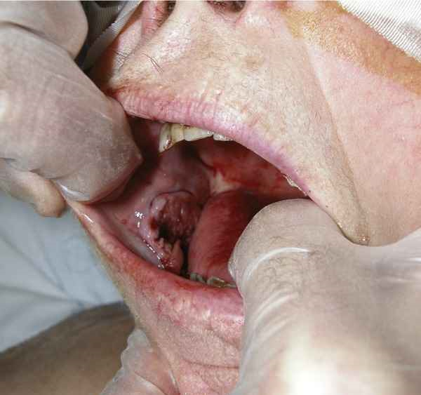
Ulcerated buccal mucosal carcinoma

Slide 16
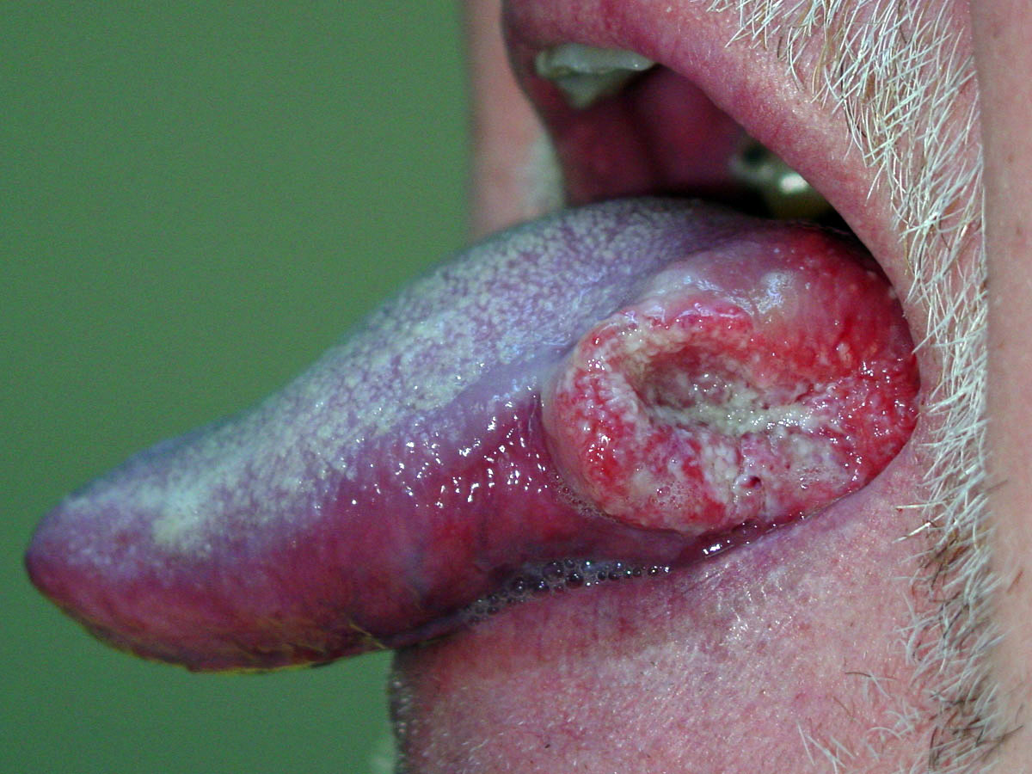
Carcinoma of the tongue on the left side

Slide 17
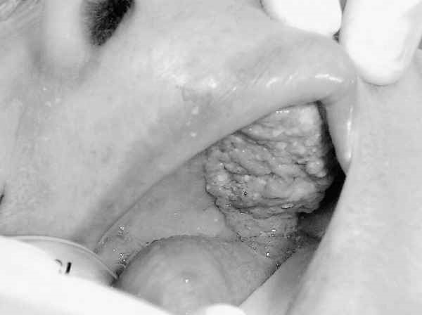
Hard palate squamous cell carcinoma on left side

Slide 18
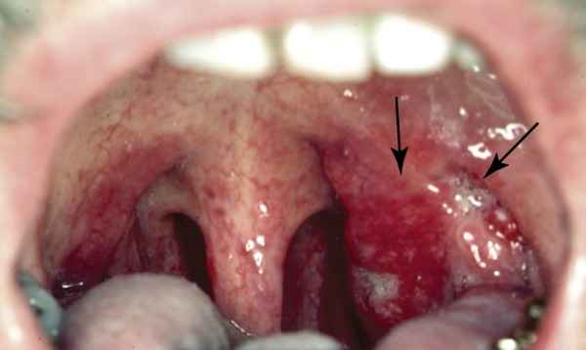
Squamous Cell Carcinoma of left tonsil, papillary in growth

Slide 19
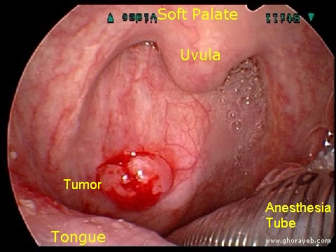
Carcinoma of the posterior pharyngeal wall

Slide 20
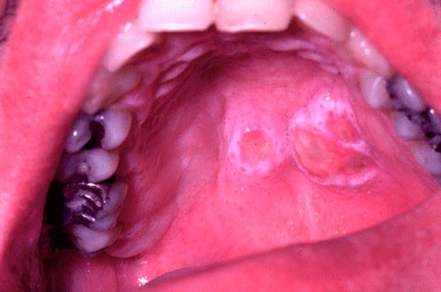
Tumor of the soft palate

Slide 21
Pathogenesis, pathology I.
The oral cavity and oropharynx is lined by squamous epithelium hence squamous cell carcinoma is the most common tumor.
However there is rich lymphoid tissue in the palatine and lingual tonsils, which gets involved with head and neck lymphomas.
Soft palate is especially rich in minor salivary glands.

Slide 22
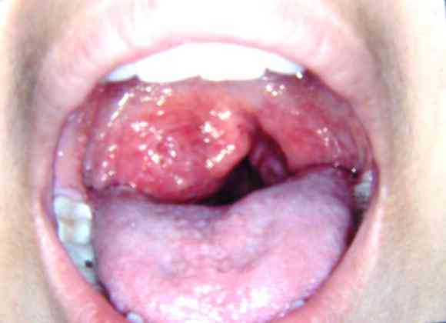
Pathogenesis, pathology II.
Squamous cell carcinoma is most common malignancy and forms 90% of tumors of this region.

Slide 23
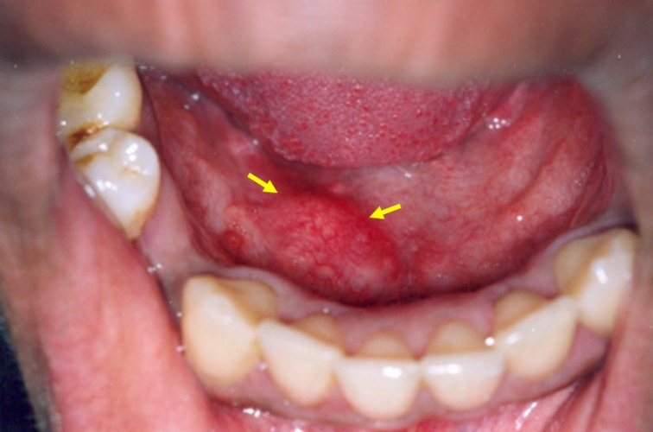
Pathogenesis, pathology III.
The most tumors of minor salivary gland tumors are pleomorphic adenomas. Elsewhere malignant tumors are the rule and include adenoid-cystic and muco-epidermoid types.

Slide 24
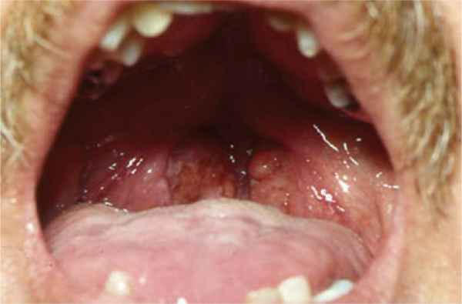
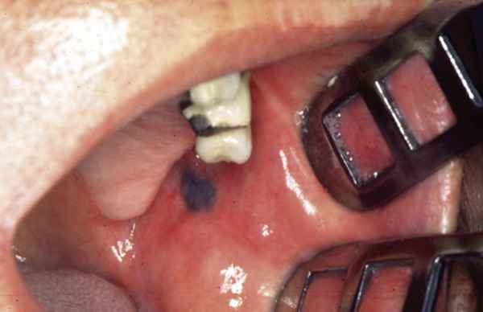
Pathogenesis, pathology IV.
Melanoma
  Lymphomas of oropharynx
  Palatine tonsil (90%)
  Tongue base 10%)
Rare malignancies:
  Sarcomas
  Malignant melanomas

Slide 25
Carcinoma of the oral cavity and oropharynx
Male/female ratio 4:1.
Most frequent between the ages of 50 to 70
histologically, 90% is squamous cell carcinoma
there are neck metastases in 60%, and 15% are bilateral (mainly tongue, floor of mouth, oropharynx)
there are distant metastases in 7% (lung, bone, liver)
Second primaries may be in the upper airways
Notes:
The incidence of lymph node involvement from cancers of the oral cavity is related to the site and size of the primary tumor. Cancers of the oral tongue and floor of mouth have a higher incidence of nodal metastases than do cancers of the lip, hard palate, and buccal mucosa.

Slide 26
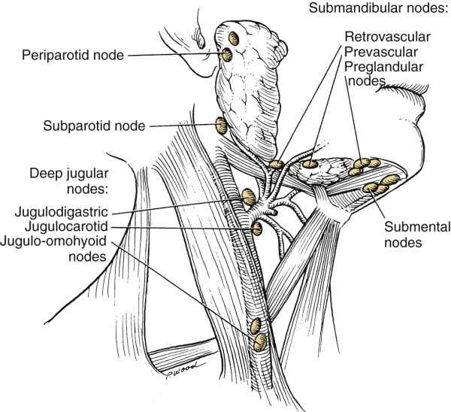

Slide 27
The signs and symptoms I.
Nonhealing ulcers, (3 weeks) or asymmetric swelling
Unusual pain in oral cavity or a sore throat
Bleeding in the mouth
Referred ear pain (there is common sensory supply by the vagus nerve)
Oral fetor
Notes:
Nonhealing ulcers <'also>
The signs and symptoms of benign and malignant lesions of the oral cavity and the oropharynx include bumps (daganat, dudor) on the lip or mouth and white or red patches (folt) in the oral cavity. Other symptoms suggesting (sugalmaz, felveti) a malignant growth (daganat, kinövés) include a nonhealing (nem gyógyuló, nem hámosodó) ulcer on the lip or mouth; unusual pain or bleeding in the mouth; difficulty or pain with chewing, swallowing, or speech; a change in the fit of dentures (fogazat illeszkedése); a change in voice; referred (utaló, itt fülbe sugárzó) ear pain; and neck masses.

Slide 28
The signs and symptoms II.
Dysphagia (difficulty swallowing)
Dysphonia (change in voice)
Neck masses
LATER:
Difficulty in chewing
Change in the fit of dentures
Trismus (if tumor involves the floor of the mouth or pterygoid space)

Slide 29
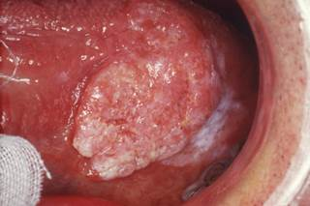

Biology and clinical appearance
HPV associated Smoking &alcohol ass.
Not hard, no pain odynophagia,
Goes to deep, into crypts exulcerated
hard
Hyst: no epithel.dyspl. epithel dyspl.
lymphocyte inf. Squamous cells
basaloid, low diff. varied diff.

Slide 30
Examination I.
Examination of mouth and oropharynx
Laryngo-pharyngoscopia (indirect, direct, laryngmicroscopy)
Feeling/Palpation (neck, tongue and base of tongue)
CT or/and MRI
Chest x-ray
Laboratory tests
PET CT
Notes:
30

Slide 31
Examination II.
Biopsy
  directly from tumor
  Ultra Sound (US) guided Fine Needle Aspiration Biopsy (FNAB) from neck masses

Slide 32
Examination of mouth and oropharynx
Examination is carried out with strong head lamp, (or flash light) using two tongue depressors
to exam the hard and soft palate, palatine tonsils, posterior wall of the pharynx, using the tongue depressors the tongue to depress
to exam the floor of the mouth, using a tongue depressor, with the tongue elevated
to exam the upper and lower vestibule of oral cavity using a depressor for buccal elevation
Notes:
Examination is carried out with good illumination head lamp, (or pupil lamp) using two tongue depressors
-to exam the hard and soft palate, palatine tonsils, posterior wall of the pharynx, using depressor as a tongue depressor,
-to exam the floor of the mouth, using a tongue depressor, with the tongue elevated.
-to exam the upper and lower vestibule of oral cavity using a depressor with bucca elevator

Slide 33
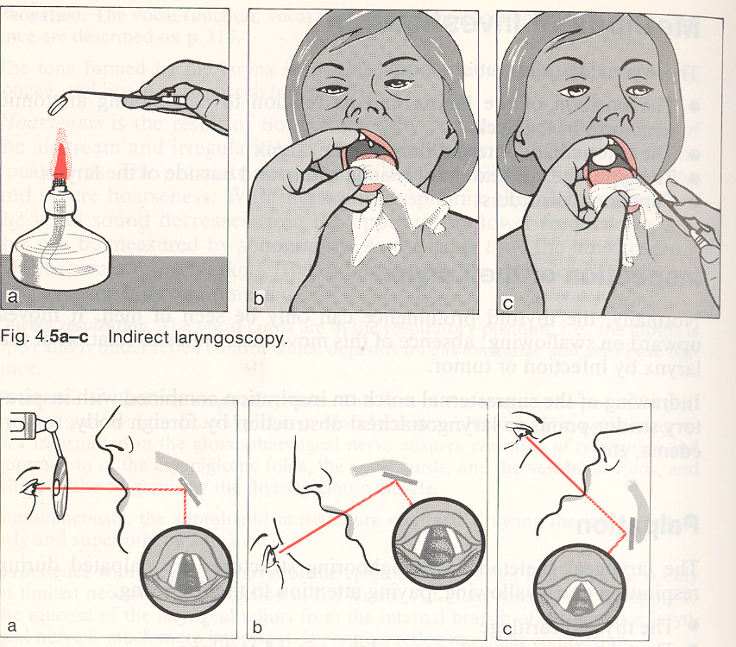
Traditional examination of the base of the tongue and larynx

Slide 34
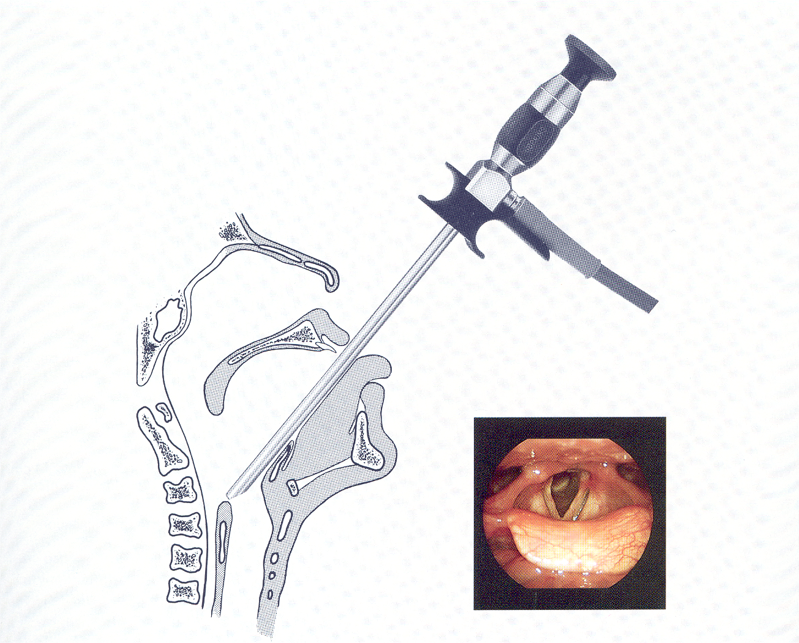
Laryngopharyngoscopy (rigid endoscope)

Slide 35
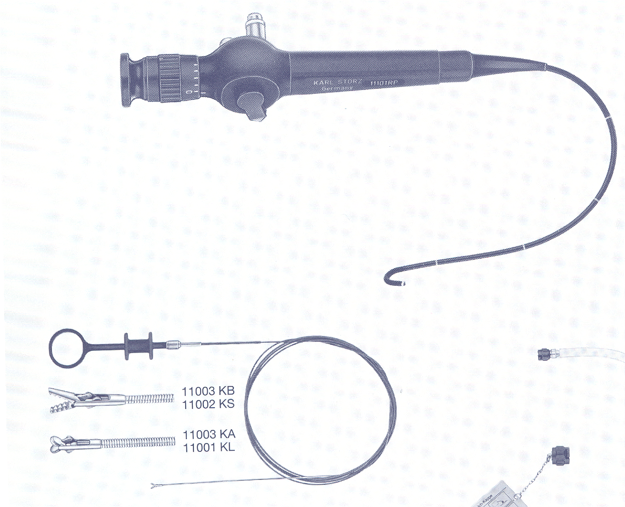
Laryngofiberoscope

Slide 36
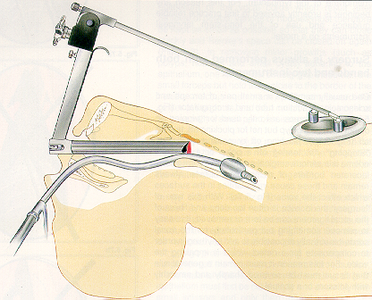
Fixation of microlaryngoscope

Slide 37
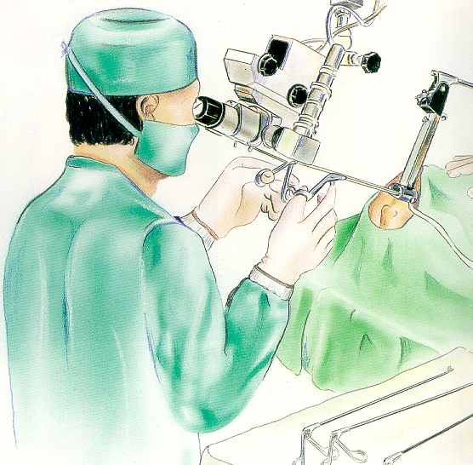
Use of microlaryngoscope

Slide 38
Feeling/Palpation
Searching for neck masses
Palpation of the tongue and tongue base (tumor size)
Notes:
38

Slide 39
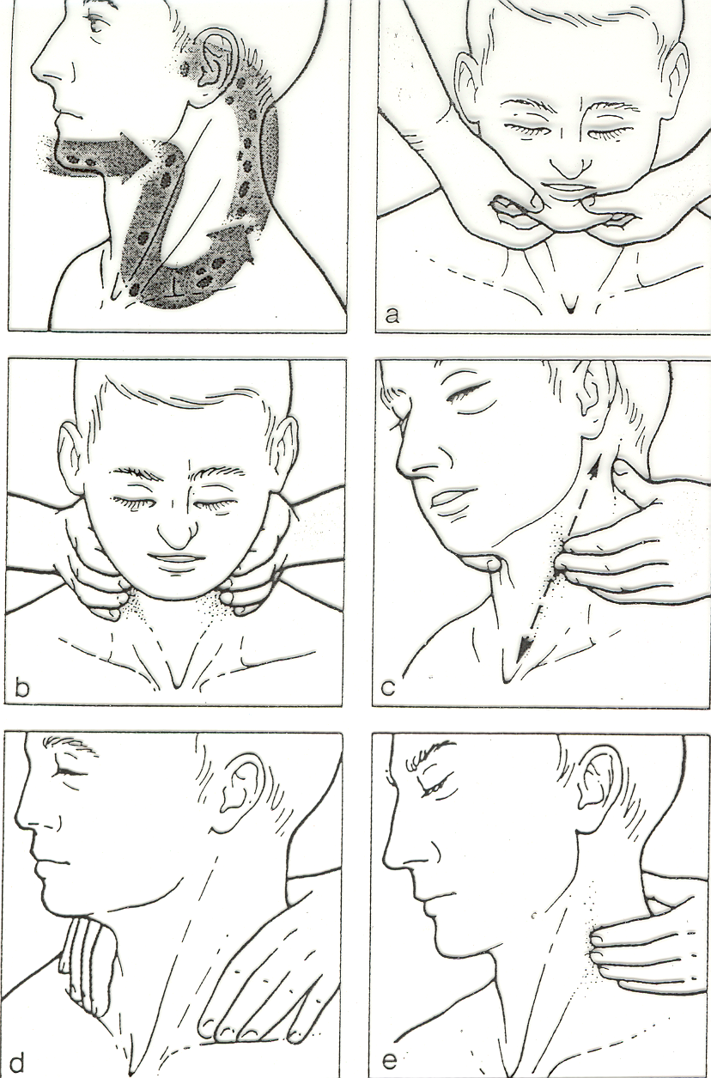
Systematic palpation of the neck
Notes:
Systematic palpation of cervical lymph nodes (with two hands)
a) Submental-submandibular region
b+c)Along the anterior border of the sternocleidomastoid muscle
d) Supraclavicular region
e) Up Along the accessory nerve and back of the neck

Slide 40
Imaging studies I.
CT
MRI
CT scan useful in evaluating the location of the primary tumor, and detecting metastasis of the neck.
MRI the most useful in detecting occult metastasis of the neck.
It is important to assess any bone infiltration (mandibular or maxillar invasion).
MRI is done to evaluate tumors of the tongue base, soft palate and tonsillar lesions.

Slide 41
MRI
Carcinoma of the tongue base on left side, and a retropharyngeal lymph node metastasis on the same side
Carcinoma of tonge on the left side

Slide 42
Imaging studies II.
PET scans help evaluate occult neck, and/or distant metastases
Chest radiograph and Barium swallow help to analyze the swallowing function
  Ultra Sound help evaluate neck metastasis and guide (FNAB) Fine Needle Aspiration Biopsy
  CT chest/abdomen useful in detecting distant metastasis

Slide 43
TNM system
Tx cc. in situ
T0 no evidence of primary
T1 tumor is 2 cm or less in its greatest dimension
T2 tumor is more than 2 cm but less than 4 cm
T3 tumor is more than 4 cm
T4 tumor with extension to surrounding structures

Slide 44
TNM system II.
Nx Regional lymph node cannot be assessed
N0 No regional lymph node metastasis
N1 Metastasis to a single ipsilateral lymph node, 3 cm or less in diameter
N2a Metastasis to a single ipsilateral lymph node more than 3 cm, but not more than 6 cm
N2b Metastasis multiple ipsilateral lymph nodes, none more than 6 cm
N2c Metastasis in bilateral or contralateral lymph nodes, none more than
6 cm
N3 Metastasis to a lymph node, more than 6 cm.

Slide 45
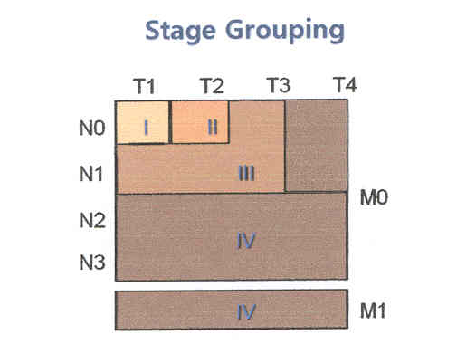
Tumor Staging:
1. Aids the clinician in the planning of treatment
2. Gives some indication of the prognosis
3. Assist in the evaluation of treatment results
4. Facilitate exchange of information between treatment centers
Notes:
As you can see, the Staging categories are only usefull if you are talking about T1, to T3, and N0 to N1. All the other possibilities fall into group IV , by definition with the worst prognowsis.

Slide 46
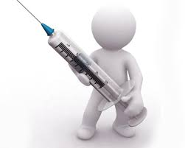
Prevention: Vaccination
Bivalent (Cervarix): 16-, 18- HPV
Quadrivalent (Gardasil, Silgard): 6-, 11-, 16-, 18-HPV
Nonavalent (Gardasil 9): 2014 dec., +31-, 33-, 45-, 52-, 58- HPV
mainly in OPC –cumulative positivity
Recommendation of American Academy of Otolaryngology – Head &Neck Surgery :
11 or 12 ys. (boys, girls)
If they didn’t get in that age:
- young girl, women until 26 ys.
- young boys, men until 21 ys.

Slide 47
Treatment Modalities
Surgery
Radiation therapy
Chemotherapy PF (platina+fluorouracil) or TPF(taxol+platina+fluoruracil)
Target biological therapy (anti EGFR)+RTX
Notes:
1. Surgery
2. Radiation therapy
3. Chemotherapy
4. Combined modality
Surgery + Postop. RTX, Preop. RTX + Surgery
Induction CTX + Surgery
Surgery + Postop. adjuvant CTX
Induction CTX + Surgery + Postop. RTX

Slide 48
Treatment Modalities II.
Surgery postop. RTX
Chemotherapy radiotherapy
Target biological therapy RTX
Induction CTX surgery

Slide 49
Principles of Head & Neck Surgery
1. Cure of the disease
2. Functional preservation
3. Surgical treatment
a. En bloc resection (primery tumor+neck metastases)
b. Wide resection margin
c. Reconstruction

Slide 50
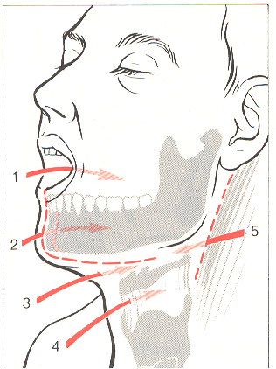
Routes of access for tumors of the mouth and pharynx.
1. Transoral;
2. Temporary mandibulotomy;
3. Supra- hyoid median pharyngotomy;
4. Subhyoid median pharyngotomy;
5. Lateral pharyngotomy.

Slide 51
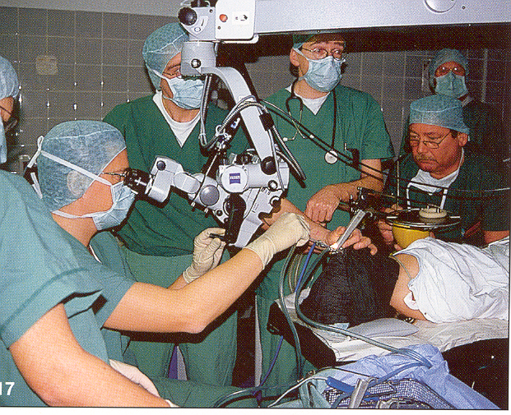
Transoral surgery
General anaesthesia
Oropharyngeal retractor, Verda laryngo-pharyngoscope
CO2 LASER, micromanipulator
Operating microscopy (magnification, and two hand manipulation)

Slide 52
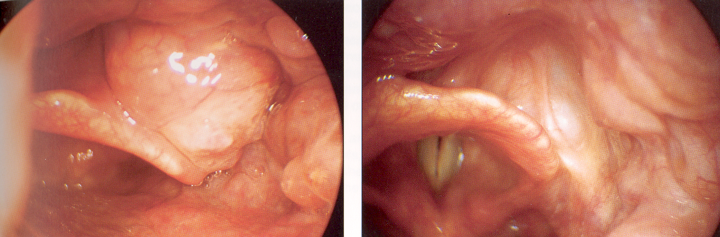
LASER excision of a tumor of the base of the tongue

Slide 53
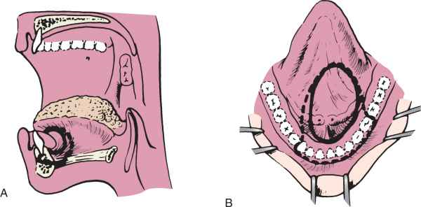
Anterior floor of mouth carcinoma treated excision
A
B
A without marginal mandibulectomy
B with marginal mandibulectomy
Notes:
Proposed excision of a tumor with (A) and without (B) marginal mandibulectomy
Anterior floor of mouth carcinoma treated with a marginal mandibulectomy

Slide 54
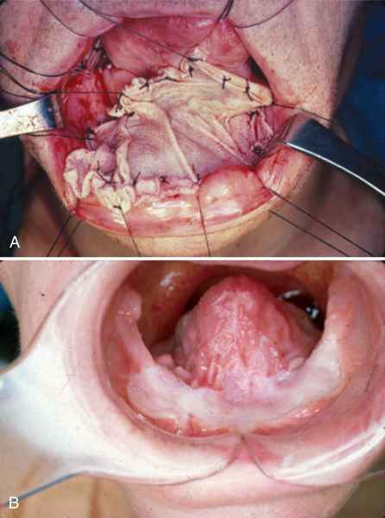
Reconstruction after an anterior floor of mouth carcinoma excision with marginal mandibulectomy
A split-thickness skin graft is sutured into place over the defect.
The skin graft overlying soft tissue and bone.
Notes:
A, A split thickness skin graft is sutured into place over the defect. B, The skin graft overlying soft tissue and bone.
Anterior floor of mouth carcinoma treated with a marginal mandibulectomy Healing stage

Slide 55
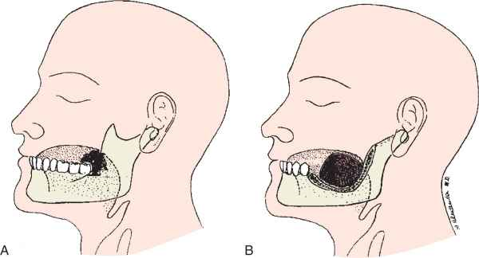
Posterior marginal mandibulectomy
posterior marginal mandibulectomy
defect after posterior marginal mandibulectomy
Notes:
A, Schematic representation of retromolar trigone lesion amenable to resection with posterior marginal mandibulectomy. B, Diagram of surgical defect after posterior marginal mandibulectomy.

Slide 56
Hard palate squamous cell carcinoma before resection.

Slide 57
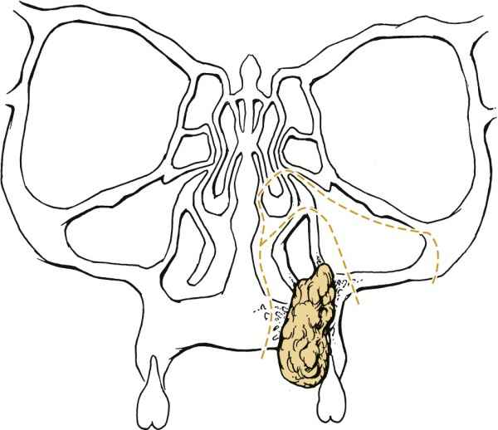
Bone cuts on an infrastructure maxillectomy for a hard palate malignancy

Slide 58
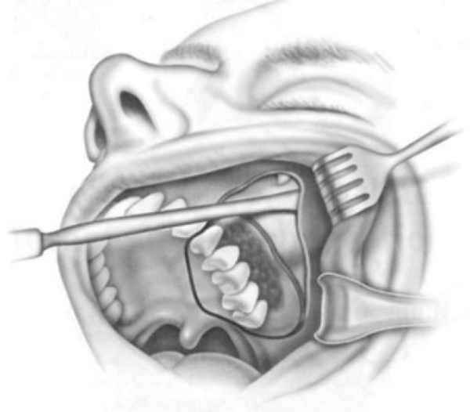
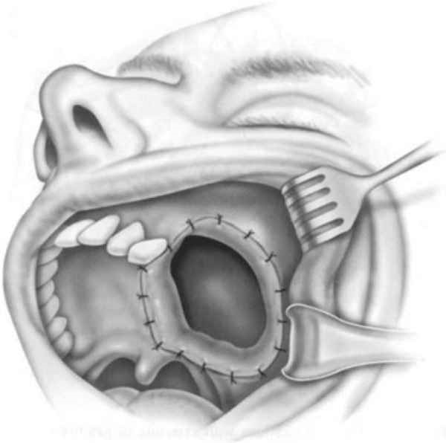
Approach to resection of a hard palate tumor which infiltrates the maxilla
Planned cuts for resection of lateral maxillary alveolus and palate..
Post-resection defect prior to reconstruction demonstrating communication with the lower aspect of the maxillary sinus.
Notes:
Approach to resection of a hard palate tumor. Weber-Ferguson incision with lip-split is shown for supero-anterior exposure. Resection exposes the inferior aspect of the nasal cavity and maxillary sinus to the oral cavity.
A, Planned cuts for resection of lateral maxillary alveolus and palate.
B, Post-resection defect prior to reconstruction demonstrating communication with the lower aspect of the maxillary sinus.
Reconstruction: The defect are closed by special obturator prothesis.

Slide 59
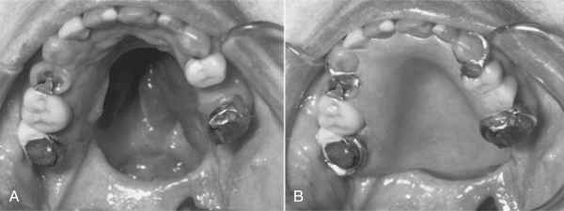
Defect and reconstruction after resection of a carcinoma of the hard palate
A. Defect between sinus and oral cavity
Keeping of the prosthesis is support by residual dentition. The prosthesis achieves good oral-nasal separation
Notes:
A, This patient underwent resection of an adenocarcinoma of the hard palate. The defect is demonstrated. B, Keeping of the prosthesis is support by residual [ri'zidzsuel] dentition. The final prosthesis achieves good oral-nasal separation( a protézis megtartását)

Slide 60
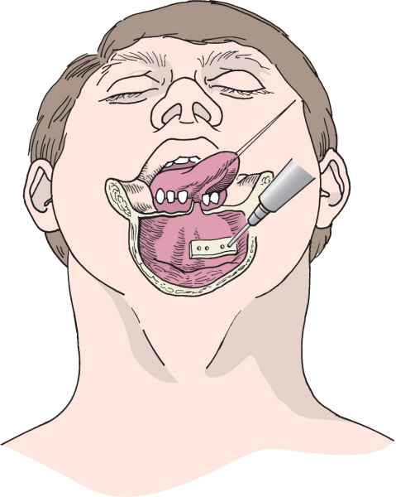
Temporary mandibulotomy I.
The plate is placed over the site of the proposed mandibulotomy, and holes are drilled before actually dividing the bone.
Notes:
The plate is placed over the site of the proposed mandibulotomy, and holes are drilled before actually dividing the bone.

Slide 61
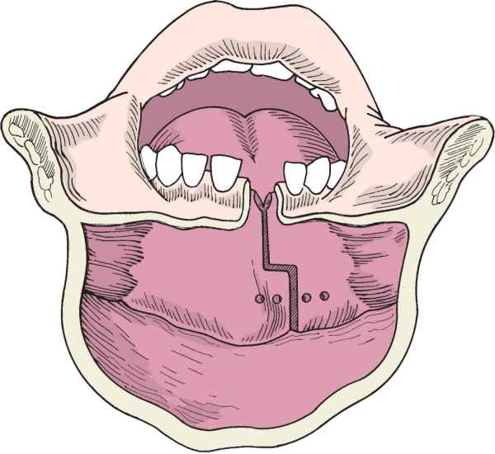
Temporary mandibulotomy II.
The mandibulotomy is undertaken through the socket of an extracted tooth.
Notes:
The mandibulotomy is undertaken through the socket of an extracted tooth

Slide 62
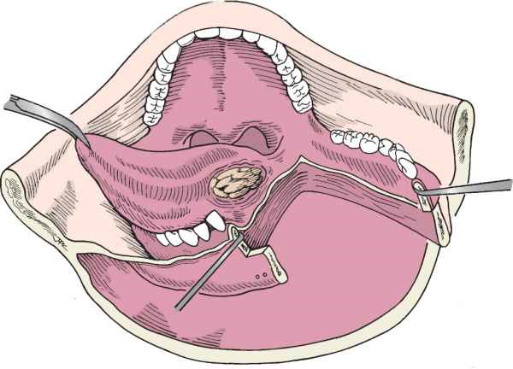
Temporary mandibulotomy III.
The mandible is retracted laterally as the mucosa of the floor of the mouth is incised.
Notes:
The mandible is retracted laterally as the mucosa of the floor of the mouth is incised. Care is taken to maintain the mucosa along the alveolus to facilitate closure.

Slide 63
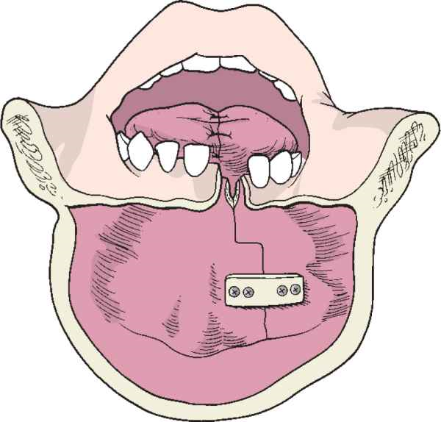
Temporary mandibulotomy IV.
The mandibular plate is applied with two screws on either side
Notes:
After reapproximation of the tongue and other soft tissues, the mandibular plate is applied with two screws on either side

Slide 64
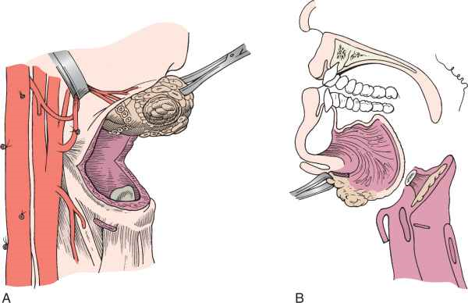
Suprahyoid pharyngectomy: for removal the tumors of the base of the tongue
Notes:
A, The tongue is grasped with a tenaculum after the suprahyoid musculature has been separated from the hyoid bone. B, Approach depicted from the lateral view.

Slide 65
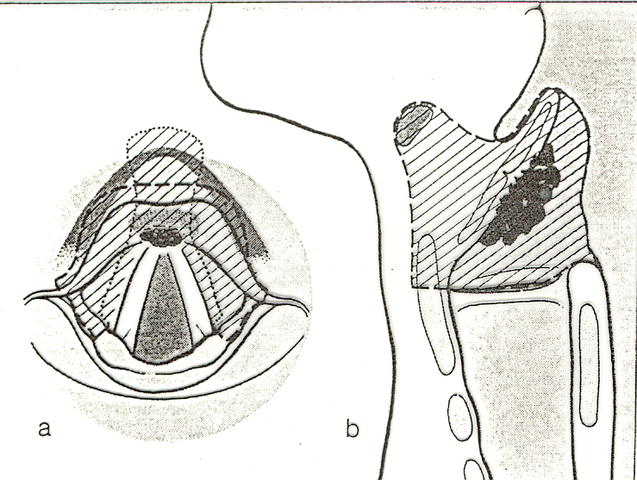
Transhyoid pharyngotomy
Horisontal supraglottic partial resection through a transhyoid pharyngotomy for the removal base of the tongue preepiglottic space, and the epiglottis
Notes:
65
Nyelvgyöki tumor resectio partialis pharyngectomiával

Slide 66
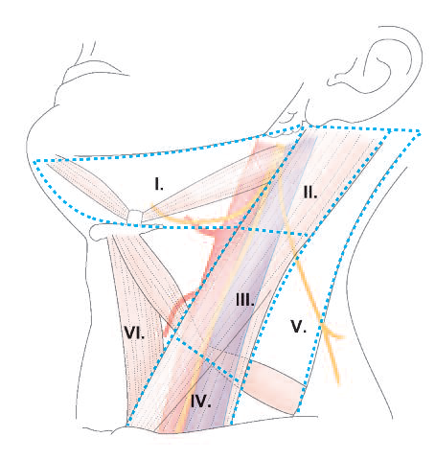
The zones of the neck
Notes:
Levels and zones

Slide 67
Treatment of neck metastasis
Radical neck dissection (RND)
Modified radical neck dissection (mRND)
Selective neck dissections
Notes:
67

Slide 68
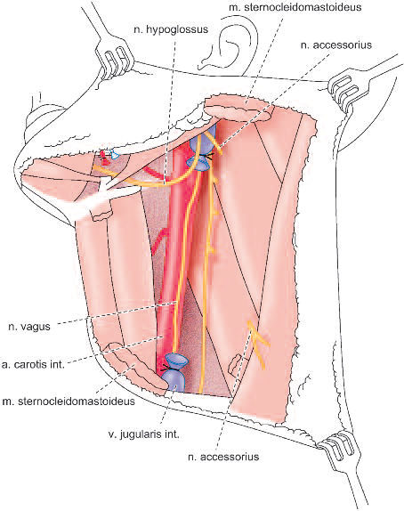
Radical neck dissection (RND)
RND is defined as removal en bloc of everything of the neck except carotid artery, Vagus, Phrenic and Hypoglossus nerves.
The indications for RND include treatment of metastatic disease of the neck.
Notes:
What we remove include: adipose tissue which contains all the lymph nodes and vessels which are contained between the mandible and the clavicle and between the superficial and deep cervical fascia; this removal also includes the sternocleidomastoid muscle, the internal jugular vein, and the Accessory nerve. Inclusive of Zones I–V.

Slide 69
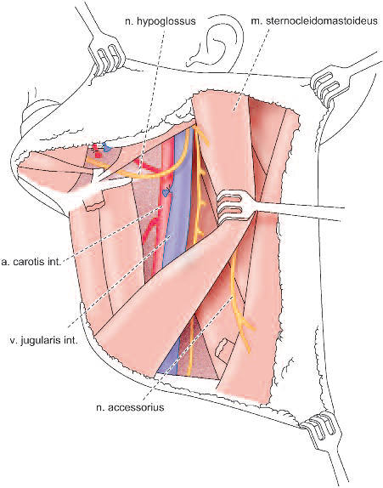
A modified radical neck dissection (MRND)
A MRND is essentially the same as the RND, but as not as aggressive, and either/or the sternocleidomast muscle, the internal jugular vein, or the accessory nerve preserved.
The indications MRND is the removal of metastatic disease of the neck where the three previous sructures have not been infiltrated.

Slide 70
Treatment of neck metastasis II.
A selective neck dissection involves the preservation of one or more zones that are typically removed in a radical neck dissection. This procedure is performed when the risk of occult metastasis to the cervical lymph nodes is greater than 20%.
A supraomohyoid neck dissection involves Zones I–III. We use it in oral cavity tumors and N0 neck disease
A lateral compartment dissection includes Zones II–IV we use it in the surgical resection of tumors of the oropharynx (larynx, hypopharynx)
Notes:
70

Slide 71
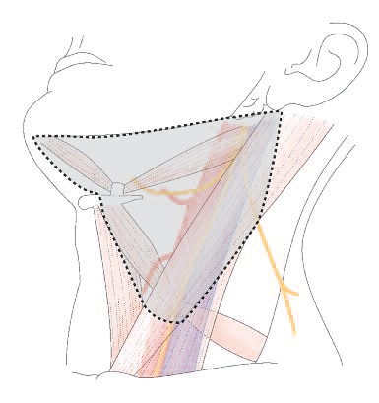
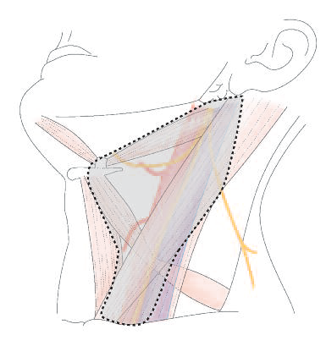
Selective neck dissection
selective neck dissection I-III zones
(supraomohyoid diss.) cc .of oral cavity
selective neck dissection I-IV zones (lateral diss.) cc. of oropharynx

Slide 72
Reconstruction
Skin graft
Local flap
Regional flap
Myocutanius flap (Pectoralis, deltopectoralis, latissimus dorsi)
Free flap (Radial Forearm Free-Tissue Flaps, Free fibula and cutan flap)

Slide 73

Pectoral major myocutanius flap I.

Slide 74

Pectoral major myocutanius flap II.
Notes:
We cut a myocutanious flap of skin .

Slide 75

Pectoral major myocutanius flap III.
Notes:
Lift up the muscle pedical which contains a vein and an artery

Slide 76

Pectoral major myocutanius flap IV.
Notes:
We burrow a tunnel over the clavicule and under the skin.

Slide 77

Pectoral major myocutanius flap V.
Notes:
We pull the pedicle and the flap through this area and place it on the defect

Slide 78

Pectoral major myocutanius flap VI.
Notes:
We suture the flap in place, and close the wounds.

Slide 79



Radial Forearm Free-Tissue Flaps
The free-tissue flap of the radial forearm is irrigated by the radial artery and cephalic vein. The skin is supplied by fasciocutaneous vessels in the intermuscular septum.

Slide 80


Slide 81


Slide 82


Slide 83
Prognosis of carcinoma of the oral cavity and the oropharynx
Tumors of the oral cavity and the oropharynx, the 5-year survival rates are approximately:
The presence of nodal metastases halves the prognosis for any given T stage. Survival rates are variable for each individual subsite.
T3 - 40%,
T4-20%.
T1 - 80%,
T2 - 60%,
Notes:
Prognosis
For T1, T2, T3, and T4 tumors of the oral cavity and the oropharynx, the 5-year survival rates are approximately 80%, 60%, 40%, and 20%, respectively (külön-külön). The presence of nodal metastases halves [ha:vz] (felezi) the prognosis for any given T stage. Survival rates are variable ['veöriébl] for each individual subsite.

Slide 84
Message I.
The oral cavity and oropharynx is unique in that, unlike other anatomic regions of the upper respiratory tract, the routine detection of early-stage lesions (precancer and cancer) is possible.
Do not forget a strong lamp and two tonge depressors!

Slide 85
Message II.
2. Systematic palpation of the neck gives a good opportunity to detect early stage lymph node metastasis (and other lymph node diseases: infections, lymphomas etc)
3. The diagnosis and treatment of these diseases are a multidisciplinary process, the ENT specialist works together radiologist, pathologist , oncologist, dentist and oral surgeon
Notes:
Systematic palpation of the neck gives a good possibility to detect early stage lymph node metastasis (and other lymph node diseses: infections, lymphomas etc)
The diagnosis and treatment of this diseases are multidisciplinary process, the ENT specialist works together radiologist, pathologist , oncologist, dentist and oral surgeon.

Slide 86








Thank you for your attention!

